Slide 1
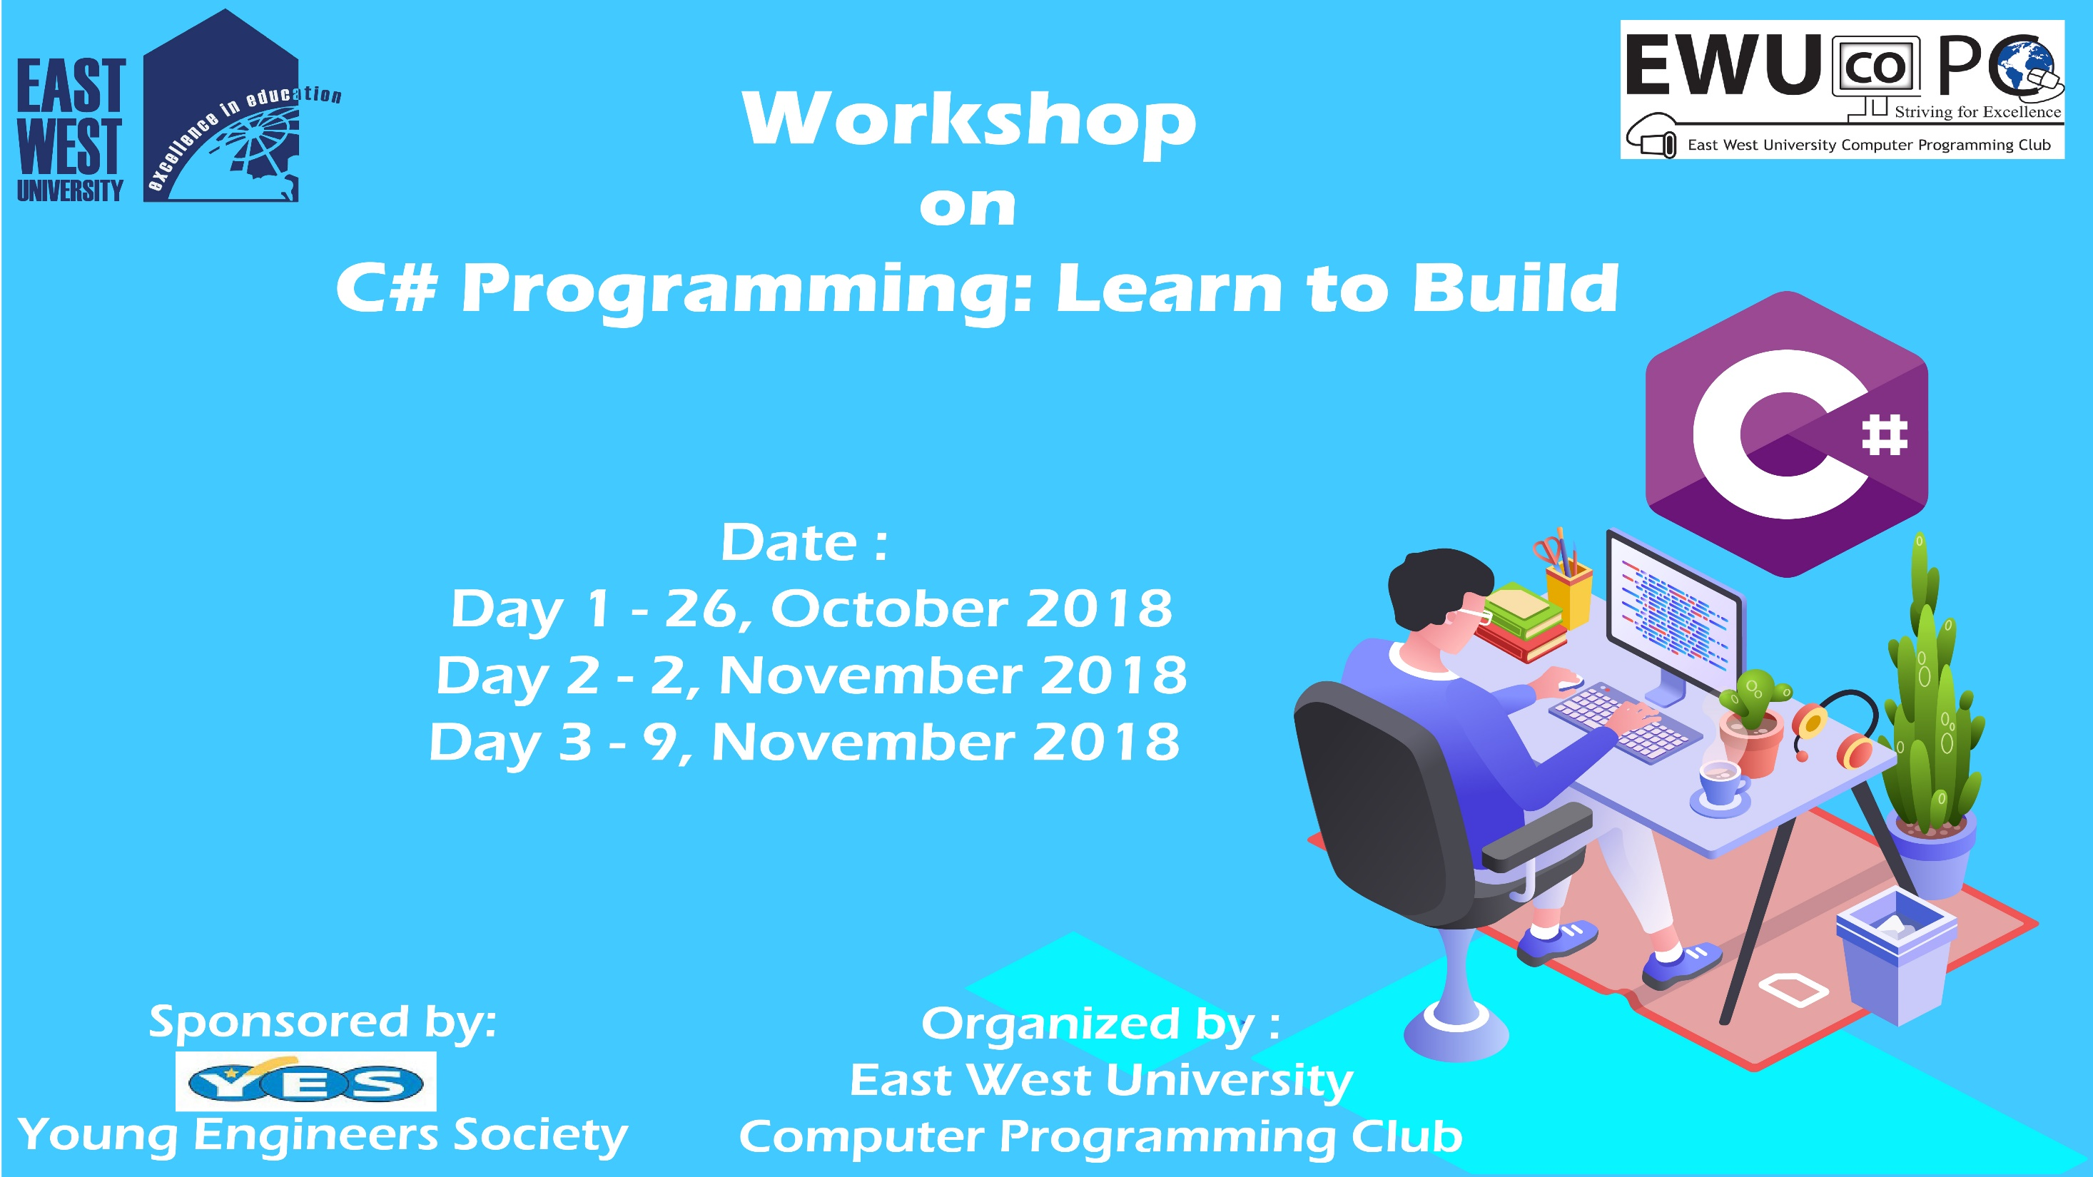

Slide 2
C# Day 1 Lecture3: Operator

Slide 3
Arithmetic Operator
+
-
*
/
%
++
--

Slide 4
Arithmetic Operator
int a = 1, b = 2, c =3;
int d = a + b * c;
int e = d / c;
int f = d % b;
Console.WriteLine(d);
Console.WriteLine(e);
Console.WriteLine(f);
Console.ReadKey();

Slide 5
Arithmetic Operator
int a =5;
a = a+ 5;
Console.WriteLine(a);

Slide 6
Arithmetic Operator
int a =5;
a += 5;
Console.WriteLine(a);

Slide 7
Arithmetic Operator
int a =5;
a = a- 5;
Console.WriteLine(a);
Or,
int a =5;
a -= 5;
Console.WriteLine(a);

Slide 8
Arithmetic Operator
int a =5;
a = a * 5;
Console.WriteLine(a);
Or,
int a =5;
a *= 5;
Console.WriteLine(a);

Slide 9
Arithmetic Operator
int a =5;
a = a/ 5;
Console.WriteLine(a);
Or,
int a =5;
a /= 5;
Console.WriteLine(a);

Slide 10
Arithmetic Operator
Pre-increment
int a =5;
++a;
Console.WriteLine(a);

Slide 11
Arithmetic Operator
Pre-increment
int a = 5, int b;
b = ++a;
Console.WriteLine(a);
Console.WriteLine(b);

Slide 12
Arithmetic Operator
Post-increment
int a =5;
a++;
Console.WriteLine(a);

Slide 13
Arithmetic Operator
Post-increment
int a = 5, int b;
b = a++;
Console.WriteLine(a);
Console.WriteLine(b);

Slide 14
Arithmetic Operator
int u = 5; int v = 3;
int x = u++ + ++v + ++u;
Console.WriteLine(x);

Slide 15
Logical Operator
&&
||
!

Slide 16
Logical Operator
Logical AND (&&)
bool res;
int num = 10, num1 = 20;
res = (num == num1) && (num>5);
Console.Writeline(res);

Slide 17
Logical Operator
Logical OR (||)
bool res;
int num = 10, num1 = 20;
res = (num == num1) || (num>5);
Console.Writeline(res);

Slide 18
Relational Operator
==
!=
>
<
>=
<=

Slide 19
Relational Operator
Equal to (==)
bool res;
int num = 10, num1 = 20;
res = (num == num1) ;
Console.Writeline(“{0} == {1} returns {2}”, num, num1, res);

Slide 20
Relational Operator
Not Equal to (!=)
bool res;
int num = 10, num1 = 20;
res = (num != num1) ;
Console.Writeline(“{0} != {1} returns {2}”, num, num1, res);

Slide 21
Relational Operator
Greater than (>)
bool res;
int num = 10, num1 = 20;
res = (num > num1) ;
Console.Writeline(“{0} > {1} returns {2}”, num, num1, res);

Slide 22
Relational Operator
Less than (<)
bool res;
int num = 10, num1 = 20;
res = (num < num1) ;
Console.Writeline(“{0} < {1} returns {2}”, num, num1, res);

Slide 23
Relational Operator
Greater than or Equal to (>=)
bool res;
int num = 10, num1 = 20;
res = (num >= num1) ;
Console.Writeline(“{0} >= {1} returns {2}”, num, num1, res);

Slide 24
Relational Operator
Less than or Equal to (<=)
bool res;
int num = 10, num1 = 20;
res = (num <= num1) ;
Console.Writeline(“{0} <= {1} returns {2}”, num, num1, res);

Slide 25
Assignment Operator
=
+=
-=
*=
/=
%=
>>=
<<=
&=
^=
|=

Slide 26
Assignment Operator
Add AND Assignment Operator (+=)
int res;
int num = 10;
res += num;
Console.Writeline(“Result of res = {0}”, res);

Slide 27
Assignment Operator
Left Shift AND Assignment Operator (<<=)
int res;
int num = 10;
res <<= num;
Console.Writeline(“Result of res = {0}”, res);

Slide 28
This slide is provided as a course material in the workshop named “Workshop on C# Programming: Learn to Build”.
Organized by-
East West University Computer Programming Club (EWUCoPC)
Prepared by- Jannat Binta Alam
Campus Ambassador
Young Engineers Society (YES)
E-mail: jannat.cse.ewu@gmail.com

